Slide 1

MService MSCTD-584
Confidential to Selfservit Solutions

Slide 2
Checklist
1.Handover Documents .

Slide 3
Repository Name:
1.MYSATAKE_IN-LIVE

Slide 4
TEST ENVIRONMENT DETAILS: URL : https://satake-in-uat.mservice.net/ Co-ordinator login : tripta/Test@123

Slide 5
Impact Analysis:
The files which is going to add and modify is
CVS/configuration_package/satake/in/last_change_timestamp.xml
CVS/configuration_package/satake/in/ui/ui_product_info_satake_in.html
DB/DATA SCRIPTS/FR-2167/03.category_type_link.sql
DB/PROCEDURES/dbo.sp_retrieve_manage_custom_info_list_mserviceAI_transactionMessagesList.sql
DB/PROCEDURES/dbo.sp_save_manage_custom_info_customer_location_contacts.StoredProcedure.sql
DB/PROCEDURES/dbo.sp_save_manage_custom_info_mserviceAI.StoredProcedure.sql
Website/fmt/msvMsg/com.selfservit.mysatake/fcmautoreply_my_activities_open_satake_in.json
Website/webui/configuration/rule/rule_manage_call_register_pe_edit_satake_in.txt
Website/webui/configuration/rule/rule_manage_call_register_se_edit_satake_in.txt
Website/webui/html/home.html
Website/www/content/product_information.html
Website/www/content/product_information_detail_prod1.html
Website/www/content/product_information_detail_prod10.html
Website/www/content/product_information_detail_prod11.html
Website/www/content/product_information_detail_prod12.html
Website/www/content/product_information_detail_prod13.html

Slide 6
Impact Analysis:
The files which is going to add and modify is
Website/www/content/product_information_detail_prod15.html
Website/www/content/product_information_detail_prod16.html
Website/www/content/product_information_detail_prod2.html
Website/www/content/product_information_detail_prod24.html
Website/www/content/product_information_detail_prod25.html
Website/www/content/product_information_detail_prod26.html
Website/www/content/product_information_detail_prod27.html
Website/www/content/product_information_detail_prod28.html
Website/www/content/product_information_detail_prod29.html
Website/www/content/product_information_detail_prod3.html
Website/www/content/product_information_detail_prod30.html
Website/www/content/product_information_detail_prod31.html
Website/www/content/product_information_detail_prod32.html
Website/www/content/product_information_detail_prod4.html
Website/www/content/product_information_detail_prod5.html
Website/www/content/product_information_detail_prod6.html
Website/www/content/product_information_detail_prod7.html
Website/www/content/product_information_detail_prod8.html

Slide 7
Impact Analysis:
The files which is going to add and modify is
Website/www/content/product_information_detail_prod9.html
CVS/access_package/satake/in/app_version_com.selfservit.mysatake_Android_GooglePlayStore.json
CVS/access_package/satake/in/last_change_timestamp.xml
CVS/configuration_package/satake/in/last_change_timestamp.xml
CVS/configuration_package/satake/in/ui/ui_product_info_satake_in.html
DB/DATA SCRIPTS/FR-2167/19.company_subscription_matrix.sql
DB/PROCEDURES/dbo.sp_retrieve_manage_custom_info_list_my_activities.StoredProcedure.sql
Website/fmt/msvNotification/SMS_VERIFYMOBILE_SECURITY_CODE.xslt
Website/www/content/product_information_detail_prod2.html
Website/www/ux/theme.settings.json

Slide 8
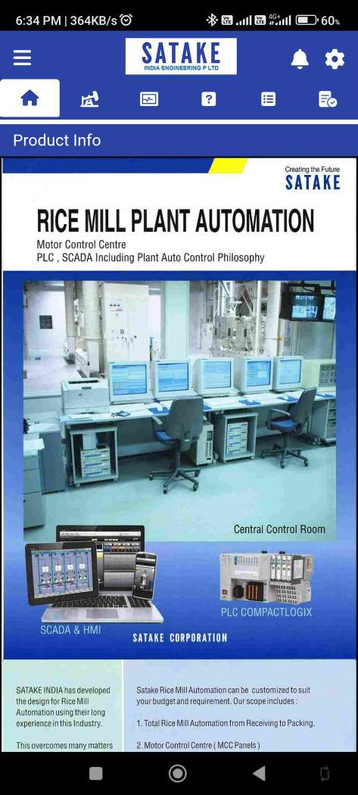
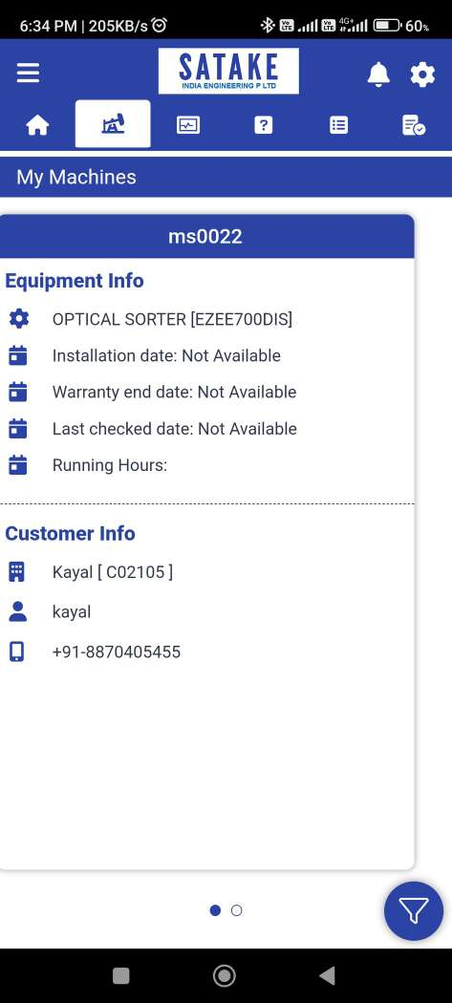
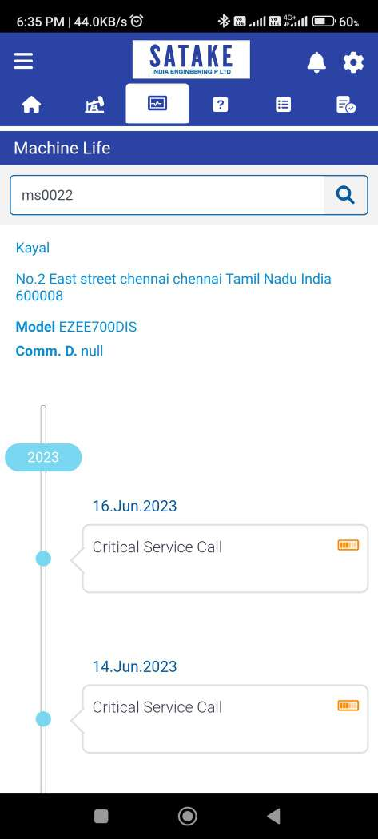

Slide 9
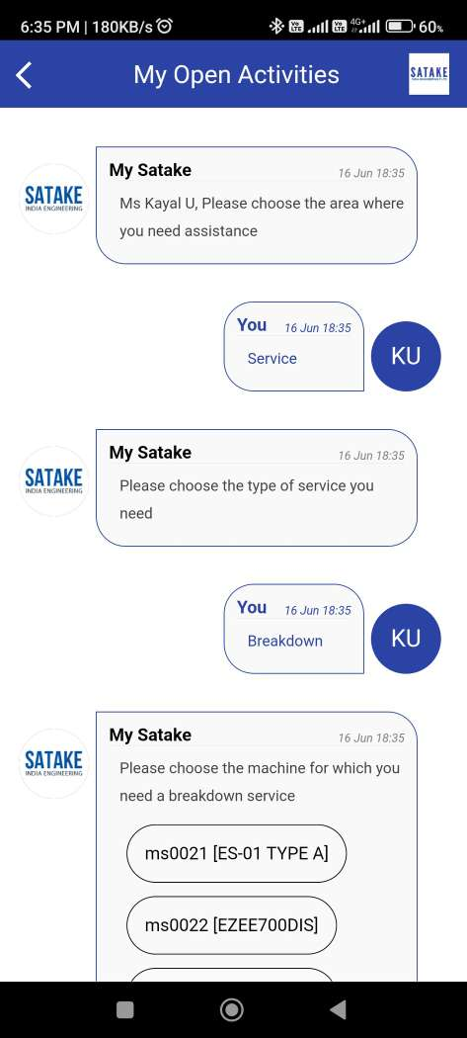
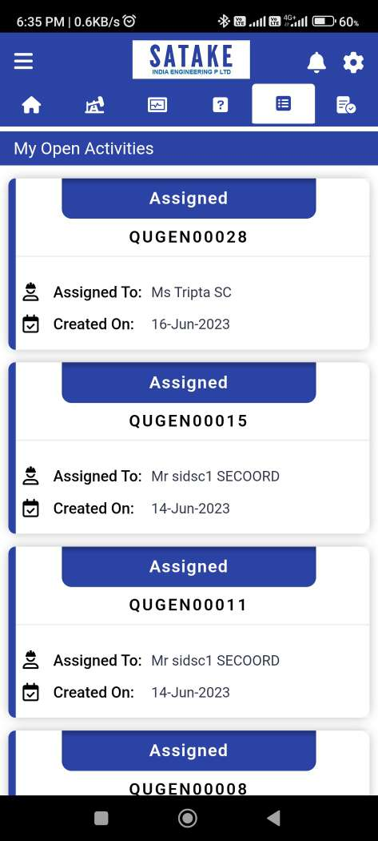
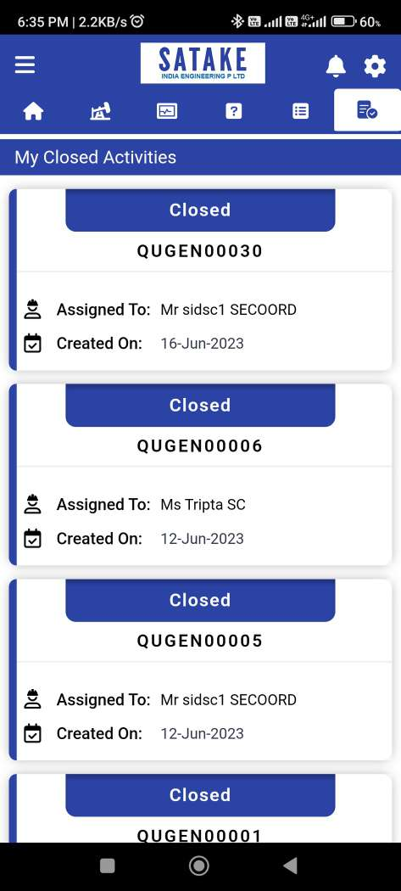

Slide 10
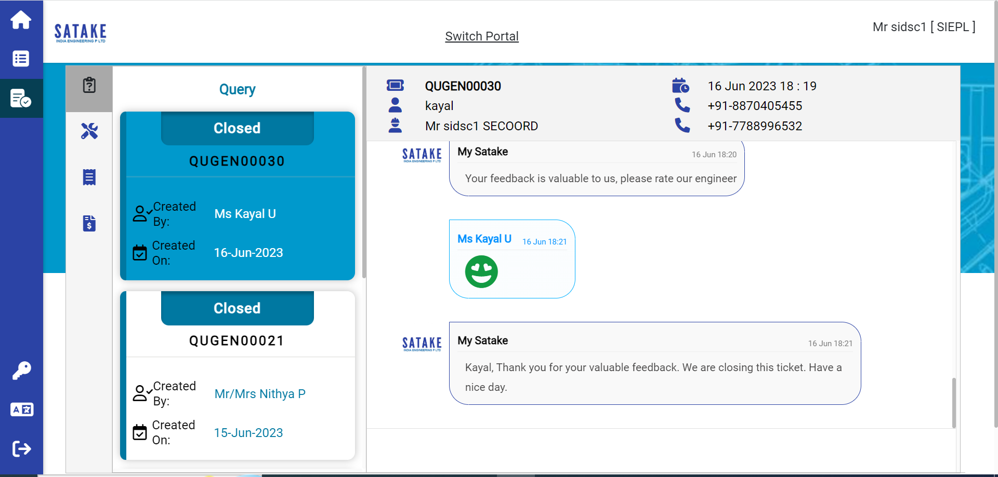

Slide 11
